Slide 1
Partial Ordering, POSETs and Lattice

Slide 2
Introduction
An equivalence relation is a relation that is reflexive, symmetric, and transitive
A partial ordering (or partial order) is a relation that is reflexive, antisymmetric, and transitive
  Recall that antisymmetric means that if (a,b) ∈ R, then (b,a) ∉ R unless b = a
  Thus, (a,a) is allowed to be in R
  But since it’s reflexive, all possible (a,a) must be in R

Slide 3
Partially Ordered Set (POSET)
A relation R on a set S is called a partial ordering or partial order if it is reflexive, antisymmetric, and transitive. A set S together with a partial ordering R is called a partially ordered set, or poset, and is denoted by (S, R)

Slide 4
Example (1)
Let S = {1, 2, 3} and
let R = {(1,1), (2,2), (3,3), (1, 2), (3,1), (3,2)}
1
2
3

Slide 5


In a poset the notation a b denotes that
This notation is used because the “less than or equal to” relation is a paradigm for a partial ordering. (Note that the symbol is used to denote the relation in any poset, not just the “less than or equals” relation.) The notation a b denotes that
a b, but

Slide 6
Example
Let S = {1, 2, 3} and
let R = {(1,1), (2,2), (3,3), (1, 2), (3,1), (3,2)}
2 2
3 2
1
2
3

Slide 7
Example (2)
Show that ≥ is a partial order on the set of integers
  It is reflexive: a ≥ a for all a ∈ Z
  It is antisymmetric: if a ≥ b then the only way that
  b ≥ a is when b = a
  It is transitive: if a ≥ b and b ≥ c, then a ≥ c
Note that ≥ is the partial ordering on the set of integers
(Z, ≥) is the partially ordered set, or poset

Slide 8

Example (3)
Consider the power set of {a, b, c} and the subset relation. (P({a,b,c}), )
Draw a graph of this relation.

Slide 9
Comparable / Incomparable
The elements a and b of a poset (S, ) are called comparable if either a b or b a. When a and b are elements of S such that neither a b nor b a, a and b are called incomparable.

Slide 10
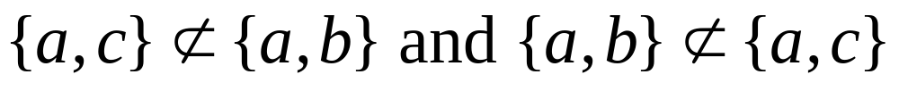
Example
Consider the power set of {a, b, c} and the subset relation. (P({a,b,c}), )
So, {a,c} and {a,b} are incomparable

Slide 11
Totally Ordered, Chains
(S, )
If is a poset and every two elements of S are comparable, S is called totally ordered or linearly ordered set, and is called a total order or a linear order. A totally ordered set is also called a chain.

Slide 12
In the poset (Z⁺,≤), are the integers 3 and 9 comparable?
  Yes, as 3 ≤ 9
Are 7 and 5 comparable?
  Yes, as 5 ≤ 7
As all pairs of elements in Z⁺ are comparable, the poset (Z⁺,≤) is a total order
  Also known as totally ordered poset, linear order, or chain

Slide 13
In the poset (Z⁺,|) with “divides” operator |, are the integers 3 and 9 comparable?
  Yes, as 3 | 9
Are 7 and 5 comparable?
  No, as 7 | 5 and 5 | 7
Thus, as there are pairs of elements in Z⁺ that are not comparable, the poset (Z⁺,|) is a partial order. It is not a chain.

Slide 14
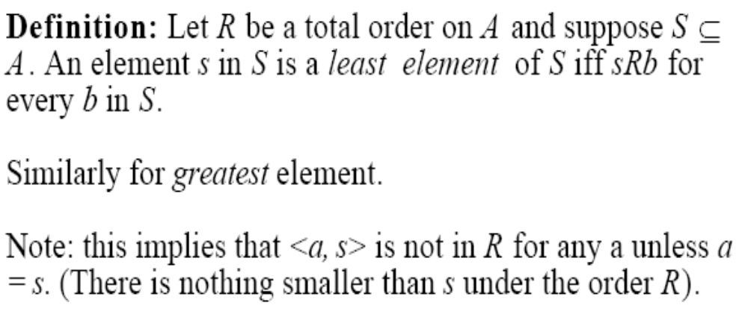

Slide 15
Well-Ordered Set
(S, )
is a well-ordered set if it is a poset such that is a total ordering and such that every nonempty subset of S has a least element.
Example: Consider the ordered pairs of positive integers, Z⁺ x Z⁺ where

Slide 16
Well-ordered sets examples
Example: (Z,≤)
  Is a total ordered poset (every element is comparable to every other element)
  It has no least element
  Thus, it is not a well-ordered set
Example: (S,≤) where S = { 1, 2, 3, 4, 5 }
  Is a total ordered poset (every element is comparable to every other element)
  Has a least element (1)
  Thus, it is a well-ordered set

Slide 17
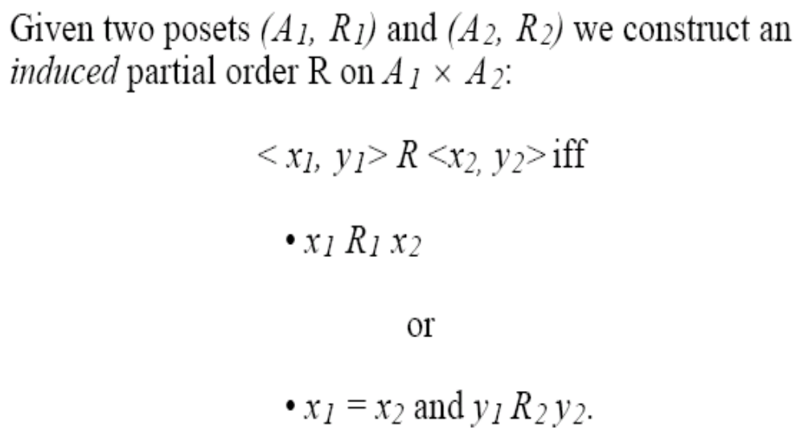
Lexicographic Order
This ordering is called lexicographic because it is the way that words are ordered in the dictionary.

Slide 18
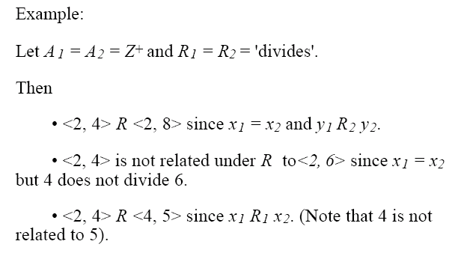

Slide 19



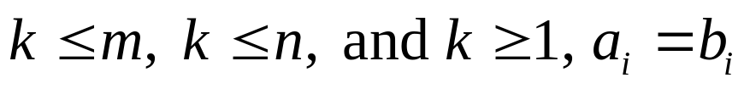


Let be a finite set and suppose R is a partial order relation defined on . Define a relation on , the set of all strings over , as follows:
For any positive integers m and n and a₁a₂…a_{m} and b₁b₂…b_{n} in .
If and a_{i} = b_{i} for all i = 1, 2, , . . ., m, then
a₁,a₂…a_{m} b₁b₂….b_{n}.
If for some integer k with
for all i = 1,2,…,k-1, and a_{k} R b_{k} but , then
a₁,a₂…a_{m} b₁b₂….b_{n}.
3. If is the null string and s is any string in
then s.

Slide 20

The Principle of Well-Ordered Induction
Suppose that S is a well-ordered set. Then P(x) is true for all x S, if:
BASIS STEP: P(x₀) is true for the least element of S, and
INDUCTION STEP: For every y S if P(x) is true for all x y, then P(y) is true.

Slide 21
Hasse Diagrams
Given any partial order relation defined on a finite set, it is possible to draw the directed graph so that all of these properties are satisfied.
This makes it possible to associate a somewhat simpler graph, called a Hasse diagram, with a partial order relation defined on a finite set.

Slide 22
Hasse Diagrams (continued)
Start with a directed graph of the relation in which all arrows point upward. Then eliminate:
the loops at all the vertices,
all arrows whose existence is implied by the transitive property,
the direction indicators on the arrows.

Slide 23
Example
Let A = {1, 2, 3, 9, 19} and consider the “divides” relation on A:
For all
18
9
2
3
1

Slide 24
Example
Eliminate the loops at all the vertices.
Eliminate all arrows whose existence is implied by the transitive property.
Eliminate the direction indicators on the arrows.
18
9
2
3
1

Slide 25
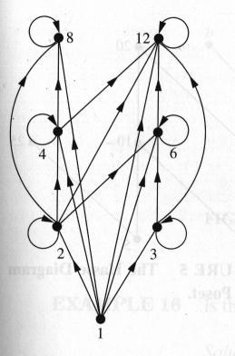
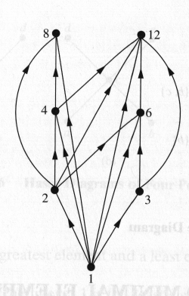
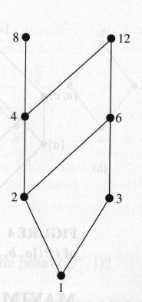
Hasse Diagram
For the poset ({1,2,3,4,6,8,12}, |)

Slide 26
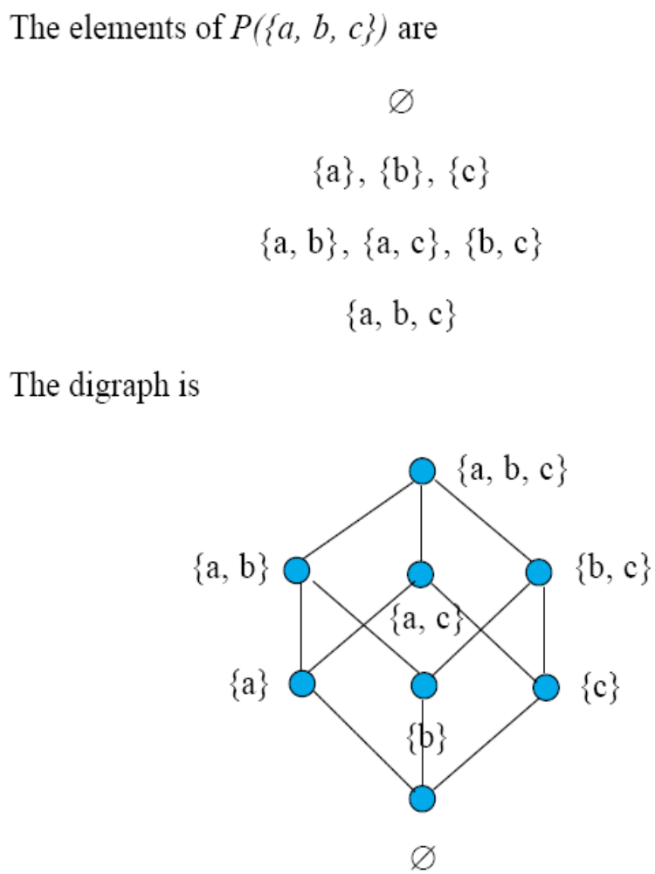

Slide 27


Maximal and Minimal Elements
a is a maximal in the poset (S, ) if there is no
such that a b. Similarly, an element of a poset is called minimal if it is not greater than any element of the poset. That is, a is minimal if there is no element
such that b a.
It is possible to have
multiple minimals and maximals.

Slide 28
Greatest Element
Least Element
a is the greatest element in the poset (S, ) if b a
for all . Similarly, an element of a poset is called the least element if it is less or equal than all other elements in the poset. That is, a is the least element if
a b for all

Slide 29

Upper bound, Lower bound
Sometimes it is possible to find an element that is greater than all the elements in a subset A of a poset (S, ). If u is an element of S such that a u for all elements , then u is called an upper bound of A. Likewise, there may be an element less than all the elements in A. If l is an element of S such that l a for all elements , then l is called a lower bound of A.
Examples PTO

Slide 30
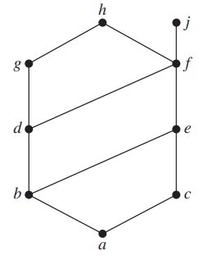
Find the lower and upper bounds of the subsets {a, b, c}, {j, h}, and {a, c, d, f } in the poset with the Hasse diagram shown in Figure
Solution: The upper bounds of {a, b, c} are e, f, j , and h, and its only lower bound is a. There are no upper bounds of {j, h}, and its lower bounds are a, b, c, d, e, and f . The upper bounds of {a, c, d, f } are f , h, and j , and its lower bound is a.

Slide 31
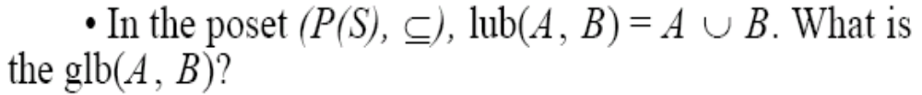
Least Upper Bound,
Greatest Lower Bound
The element x is called the least upper bound (lub) of the subset A if x is an upper bound that is less than every other upper bound of A.
The element y is called the greatest lower bound (glb) of A if y is a lower bound of A and z y whenever z is a lower bound of A.
Examples 1 and 2 PTO.

Slide 32
1. Find the greatest lower bound and the least upper bound of {b, d, g}, if they exist, in the poset shown in Figure .
Solution: The upper bounds of {b, d, g} are g and h.
Because g ≺ h, g is the least upper bound.
The lower bounds of {b, d, g} are a and b.
Because a ≺ b, b is the greatest lower bound.
2. Find the greatest lower bound and the least upper bound of the sets
{3, 9, 12} and {1, 2, 4, 5, 10}, if they exist, in the poset (Z+, |)
Solution: An integer is a lower bound of {3, 9, 12} if 3, 9, and 12 are divisible by this integer. The only such integers are 1 and 3. Because 1 | 3, 3 is the greatest lower bound of {3, 9, 12}. The only lower bound for the set {1, 2, 4, 5, 10} with respect to | is the element 1. Hence, 1 is the greatest lower bound for {1, 2, 4, 5, 10}.

Slide 33
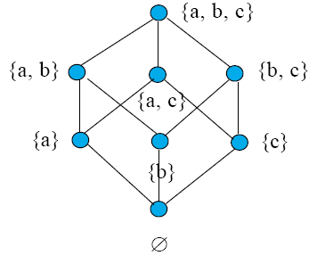

Lattices
A partially ordered set in which every pair of elements has both a least upper bound and a greatest lower bound is called a lattice.

Slide 34
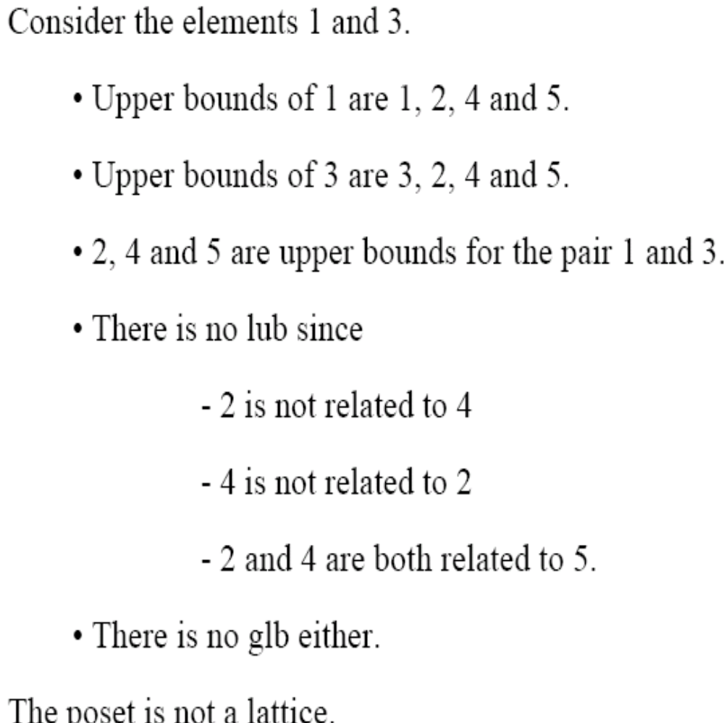
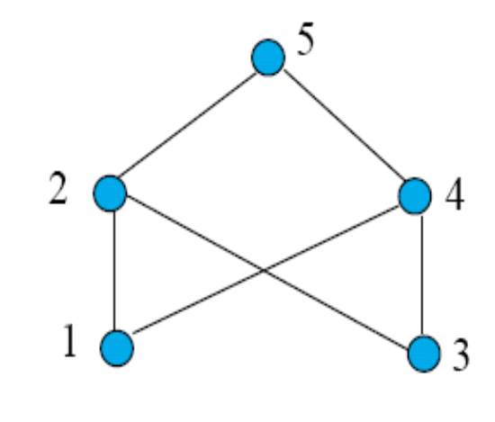
Examples 21 and 22, p. 575 in Rosen.

Slide 35
Definition of chain: A chain in a partially ordered set is a subset of elements which are all comparable to each other.
Definition of antichain: An antichain is a subset of elements, no two of which are comparable to each other.
The width of a finite partially ordered set S is the maximum size of an antichain in S. In other words, the width of a finite partially ordered set S is the minimum number of chains needed to cover S, i.e. the minimum number of chains such that any element of S is in at least one of the chains.

Slide 36
Example
Let S be the set of divisors of 30, with divisibility as the partial order.
Then the following chains cover S :
{1, 2, 6, 30}, {3, 15}, {5, 10}
And {2, 3, 5} is an antichain of length 3.
It is not immediately obvious, but the chain cover is minimal (though not unique),
and the antichain is maximal (though not unique).
So both definitions of width give 3 for this partially ordered set.

Slide 37
Topological Sorting
A total ordering is said to be compatible with the partial ordering R if
a b whenever a R b. Constructing a total ordering from a partial ordering is called topological sorting.
Suppose that a project is made up of 20 different tasks. Some tasks can be completed only after others have been finished. How can an order be found for these tasks? To model this problem we set up a partial order on the set of tasks so that a ≺ b if and only if a and b are tasks where b cannot be started until a has been completed.
To produce a schedule for the project, we need to produce an order for all 20 tasks that is compatible with this partial order. We will show how this can be done.

Slide 38
Find a compatible total ordering for the poset ({1, 2, 4, 5, 12, 20}, |).
Solution: The first step is to choose a minimal element.
This must be 1, because it is the only minimal element.
Next, select a minimal element of ({2, 4, 5, 12, 20}, |).
There are two minimal elements in this poset, namely, 2 and 5. We select 5.
The remaining elements are {2, 4, 12, 20}. The only minimal element at this stage is 2. Next, 4 is chosen because it is the only minimal element of ({4, 12, 20}, |). Because both 12 and 20 are minimal elements of ({12, 20}, |), either can be chosen next.
We select 20, which leaves 12 as the last element left. This produces the total ordering 1 ≺ 5 ≺ 2 ≺ 4 ≺ 20 ≺ 12

Slide 39
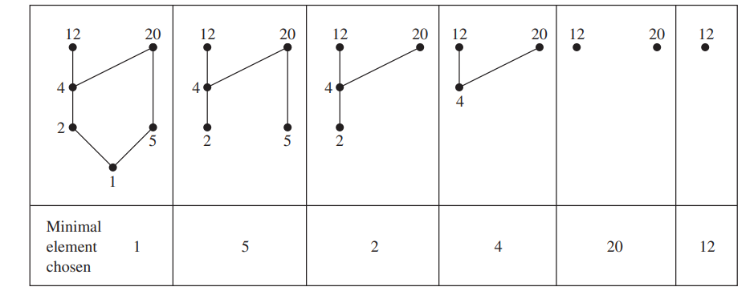

Slide 40

Example
Consider the set A = {2, 3, 4, 6, 18, 24} ordered by the “divides” relation. The Hasse diagram follows:
24
18
4
6
2
3
The ordinary “less than or equal to” relation on this set is a topological sorting for it since for positive integers a and b, if a|b then a b.

Slide 41
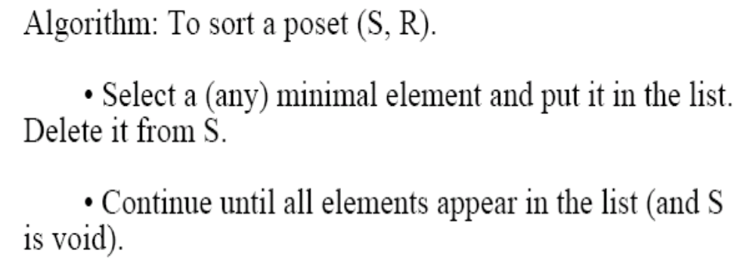
Topological Sorting

Slide 42
Assemble an Automobile
Build Frame
Install engine, power train components, gas tank.
Install brakes, wheels, tires.
Install dashboard, floor, seats.
Install electrical lines.
Install gas lines.
Attach body panels to frame
Paint body.

Slide 43
Prerequisites
Task | Immediately Preceding Tasks | Time Needed to Perform Task
1 2 3 4 5 6 7 8 9 | 1 1 2 2, 3 4 2, 3 4, 5 6, 7, 8 | 7 hours 6 hours 3 hours 6 hours 3 hours 1 hour 1 hour 2 hours 5 hours

Slide 44
Example – Job Scheduling
What is the total order compatible with it?
Task 4
6 hours
Task 6
1 hour
Task 2
6 hours
Task 1
7 hours
Task 5
3 hours
Task 3
3 hours
Task 9
5 hour
Task 8
2 hour
Task 7
1 hour

Slide 45
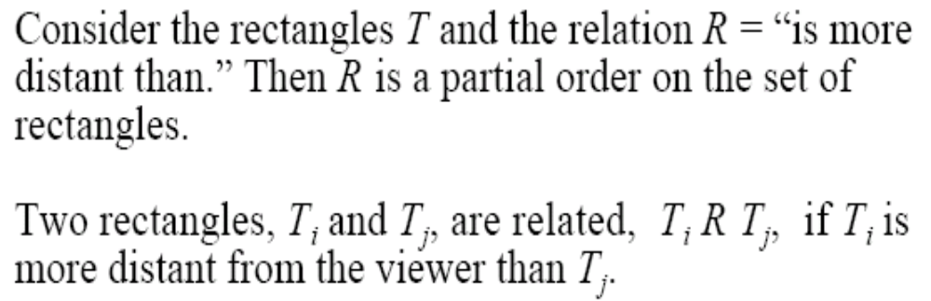
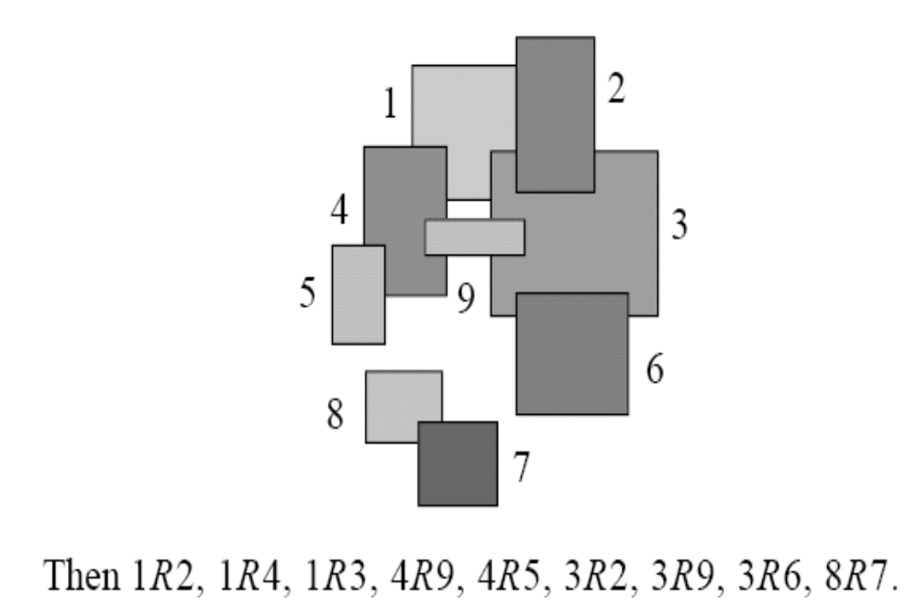

Slide 46
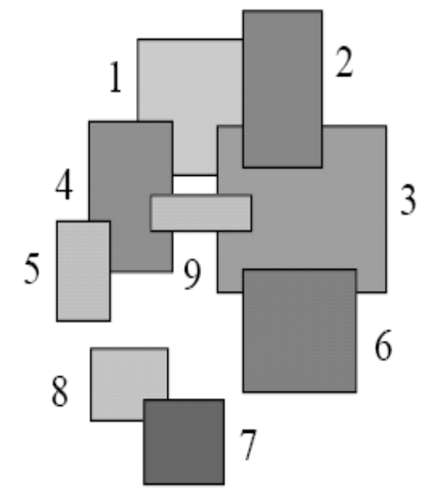
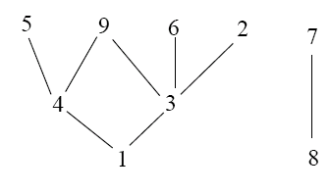
Example 27, p. 578 in Rosen.

Slide 47
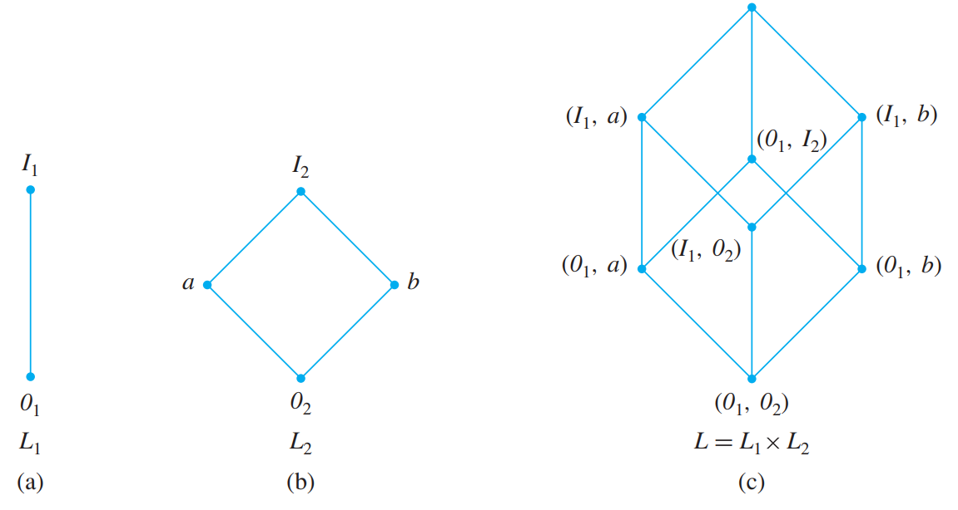
Direct Product of Lattices

Slide 48
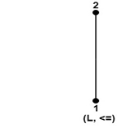
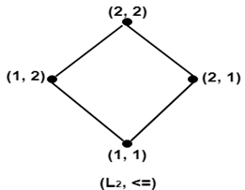
Let (L1 ∨1 ∧1)and (L2 ∨2 ∧2) be two lattices. Then (L, ∧,∨) is the direct product of lattices, where L = L1 x L2 in which the binary operation ∨(join) and ∧(meet) on L are such that for any (a1,b1)and (a2,b2) in L.
Example: Consider a lattice (L, ≤) as shown in fig. where L = {1, 2}. Determine the lattices (L2, ≤), where L2=L x L.
Solution: The lattice (L2, ≤) is shown in fig:

Slide 49
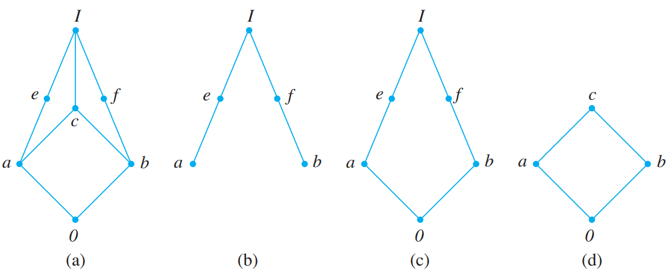


Consider the lattice L shown in (a). The partially ordered subset Sb shown in Figure (b) is not a sublattice of L since .
The partially ordered subset Sc in Figure (c) is not a sublattice of L since
However, observe that Sc is a lattice when considered a poset by itself. The
partially ordered subset Sd in Figure (d) is a sublattice of L.

Slide 50
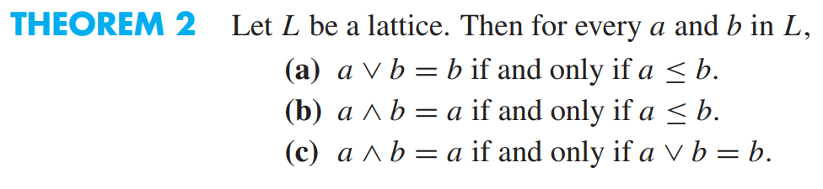
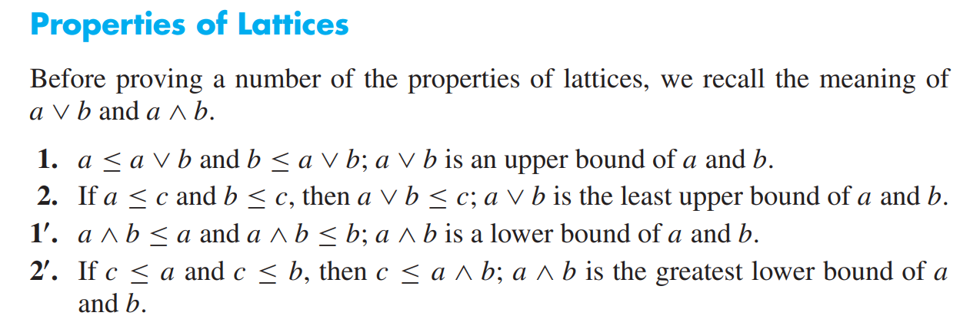

Slide 51
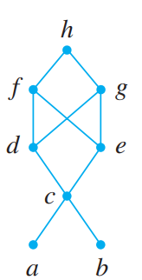
Consider the poset A = {a, b, c, d, e, f, g, h}, whose Hasse diagram is shown in Figure. Find all upper and lower bounds of the following subsets of A: (a)
B1 = {a, b}; (b) B2 = {c, d, e}.
Solution
(a) B1 has no lower bounds; its upper bounds are c, d, e, f , g, and h.
(b) The upper bounds of B2 are f , g, and h; its lower bounds are c, a, and b.

Slide 52
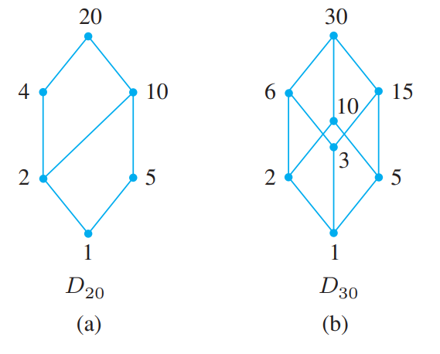
Prove the following: Consider the poset (Z+, ≤), where for a and b in Z+, a ≤ b if and only if a | b.
Then L is a lattice in which the join and meet of a and b are their least common
multiple and greatest common divisor, respectively. That is,
a ∨ b = LCM(a, b) and a ∧ b = GCD(a, b).
Let n be a positive integer and let Dn be the set of all positive divisors of n. Then
Dn is a lattice under the relation of divisibility.
Thus, if n = 20, we have D20 = {1, 2, 4, 5, 10, 20}. The Hasse diagram of D20 is shown in Figure (a). If n = 30, we have D30 = {1, 2, 3, 5, 6, 10, 15, 30}. The Hasse
diagram of D30 is shown in Figure (b).

Slide 53
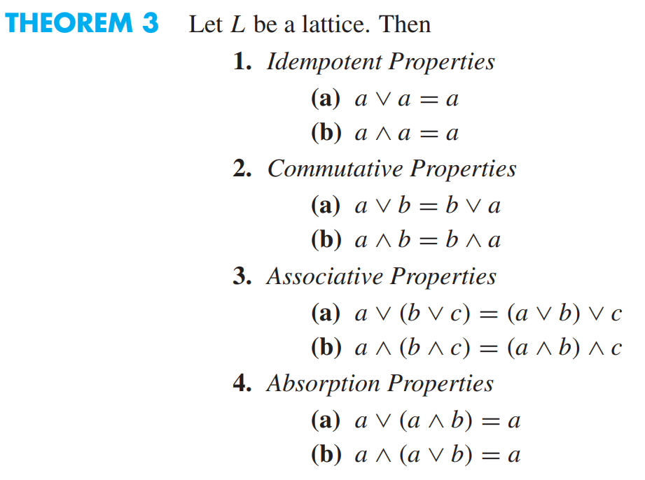
Duality:
The dual of any statement in a lattice (L,∧ ,∨ ) is defined to be a statement that is obtained by interchanging ∧ an ∨.

Slide 54
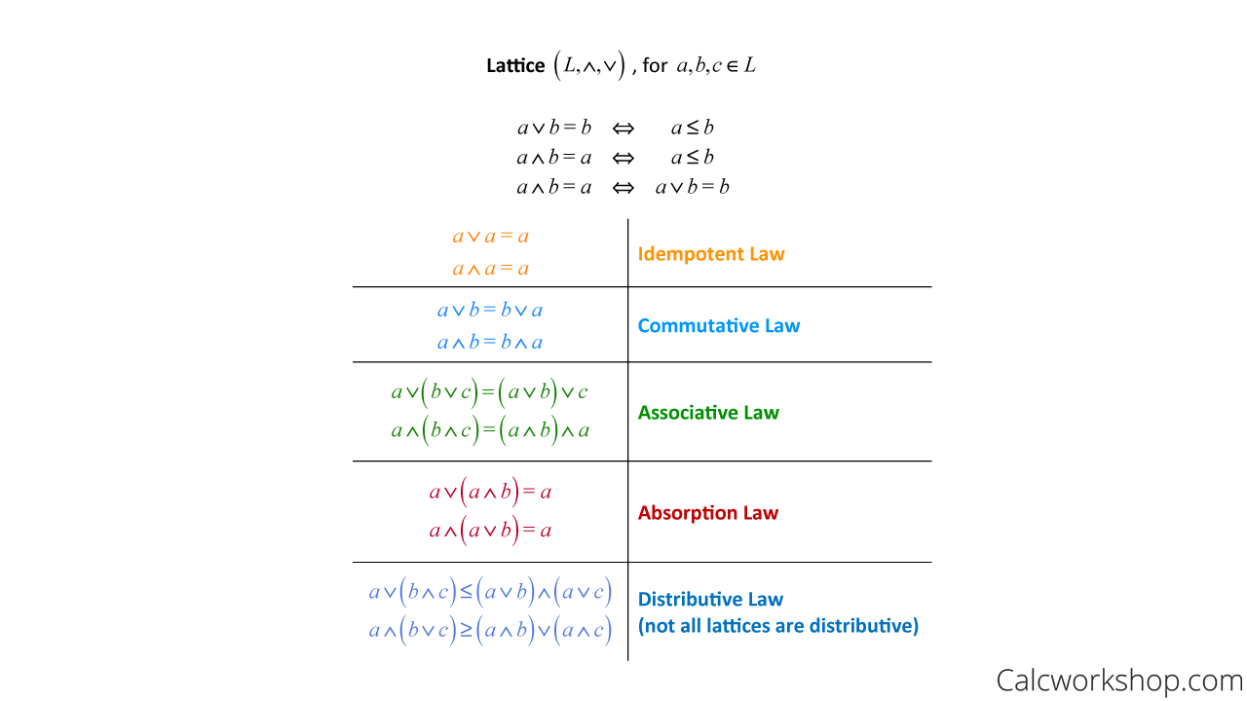

Slide 55
Types of Lattice: 1. Bounded
Consider the poset (Z+, ≤), where for a and b in Z+, a ≤ b if and only if a | b.
Then L is a lattice in which the join and meet of a and b are their least common multiple and greatest common divisor, respectively.
That is, a ∨ b = LCM(a, b) and a ∧ b = GCD(a, b).
Let L = {a1, a2,..., an} be a finite lattice. Then L is bounded.
The greatest element of L is a1 ∨ a2 ∨···∨ an, and its least element is a1 ∧ a2 ∧ ···∧ an.

Slide 56
Is Lattice Z+ and Z bounded lattice?
As defined above, the lattice Z+ under the partial order of divisibility is not a bounded lattice since it has the least element, the number 1, but no greatest element.
The lattice Z under the partial order ≤ is not bounded since it has neither a greatest nor a least element.

Slide 57
Sub-Lattices:
Consider a non-empty subset L1 of a lattice L. Then L1 is called a sub-lattice of L if L1 itself is a lattice i.e., the operation of L i.e., a ∨ b ∈ L1 and a ∧ b ∈ L1 whenever a ∈ L1 and b ∈ L1.
Example: Consider the lattice of all +ve integers I+ under the operation of divisibility. The lattice Dn of all divisors of n > 1 is a sub-lattice of I+.
Determine all the sub-lattices of D30 that contain at least four elements, D30={1,2,3,5,6,10,15,30}.
Solution: The sub-lattices of D30 that contain at least four elements are as follows:
1. {1, 2, 6, 30} 2. {1, 2, 3, 30} 3. {1, 5, 15, 30} 4. {1, 3, 6, 30}
5. {1, 5, 10, 30} 6. {1, 3, 15, 30} 7. {2, 6, 10, 30}

Slide 58
Types of Lattice: 2. Distributive
A lattice L is called distributive if for any elements a, b, and c in L we have
the following distributive properties:
1. a ∧ (b ∨ c) = (a ∧ b) ∨ (a ∧ c)
2. a ∨ (b ∧ c) = (a ∨ b) ∧ (a ∨ c)
If L is not distributive, we say that L is nondistributive
For a set S, the lattice P(S) is distributive, since union and intersection (the join and meet, respectively) each satisfies the distributive property.

Slide 59
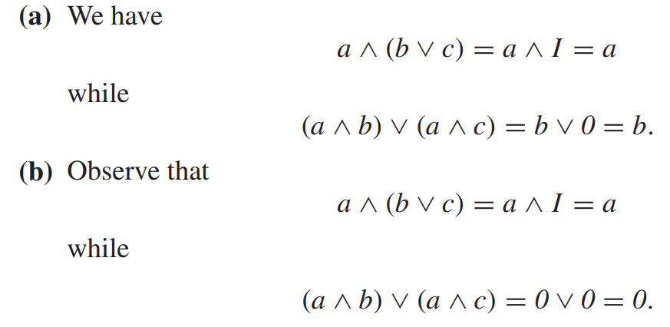
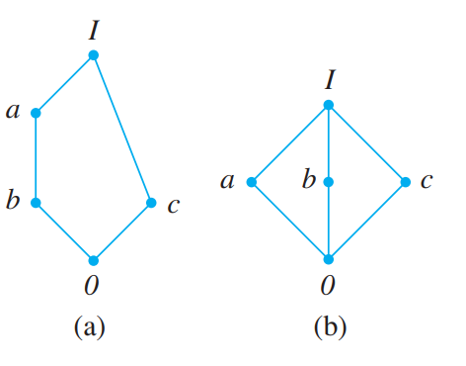
Exercise: Show that the lattices pictured in Figure below are nondistributive.

Slide 60
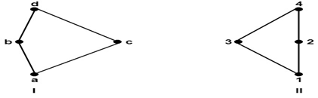
Types of Lattice: 3. Isomorphic Lattices:
Two lattices L1 and L2 are called isomorphic lattices if there is a bijection from L1 to L2 i.e., f: L1⟶ L2, such that f (a ∧ b) =f(a)∧ f(b) and f (a ∨ b) = f (a) ∨ f (b)
Example: Determine whether the lattices shown in figures are isomorphic.
Solution: The lattices shown in fig are isomorphic.
Consider the mapping f = {(a, 1), (b, 2), (c, 3), (d, 4)}.
For example f (b ∧ c) = f (a) = 1.
Also, we have f (b) ∧ f(c) = 2 ∧ 3 = 1

Slide 61
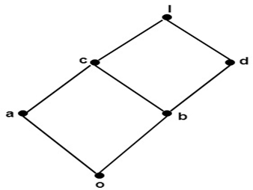
Types of Lattice: 4. Complements and complemented lattices: Let L be a bounded lattice with lower bound o and upper bound I.
Let a be an element of L.
An element x in L is called a complement of a
if a ∨ x = I and a ∧ x = 0
A lattice L is said to be complemented if L is bounded and every element in L has a complement.
Example: Determine the complement of a and c in fig:
Solution: The complement of a is d. Since, a ∨ d = 1 and a ∧ d = 0. The complement of c does not exist. Since, there does not exist any element c such that c ∨ c'=1 and c ∧ c'= 0.

